Slide 1
COMMUNICATION SKILLS
2024

Slide 2
Learning Objectives
Basic principles of communication
Communication process.
Types of communication

Slide 3
What is Communication
This is the transmission and reception of messages
involves thinking about what you are reading or hearing
Watches out for change in behavior, body language or technology adoption
Interpretation and feedback

Slide 4
Basic communication principles(7c`s)
Clarity: Deliver your message in a clear and easily understandable manner.
Conciseness: Express your ideas and information in a concise and to-the-point manner.
Completeness: Ensure that your message is complete and comprehensive. Provide all the necessary information, facts, and details required for the recipient to understand.
Correctness: Maintain accuracy and correctness in your communication. Use appropriate grammar, spelling, and punctuation.

Slide 5
5. Courtesy: Communicate with respect, politeness, and professionalism. Be mindful of your tone, choose appropriate language, and show consideration for the feelings and perspectives of others.
6. Consideration: Take into account the needs, interests, and expectations of your audience. Tailor your message to their background, knowledge, and preferences.
7.Concrete: Make your message concrete and specific by providing tangible examples, evidence, or visuals. This helps in makes your communication more relatable and memorable.

Slide 6
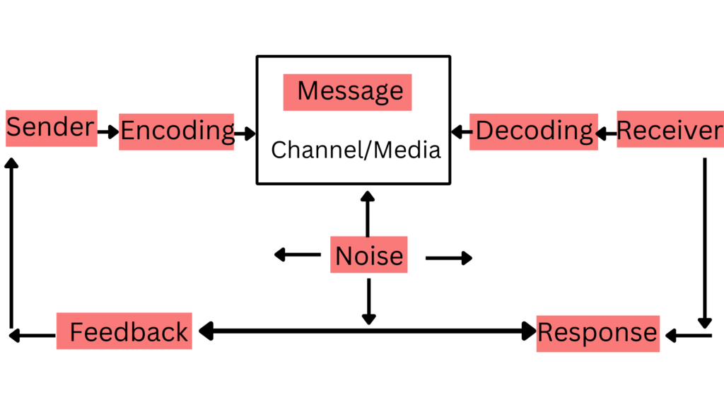
Communication Process

Slide 7
Sender: Initiates the communication process, conceptualizes the message and expresses himself effectively
Encoding: sender formulates the message by organizing their thoughts, selecting appropriate words or symbols, and considering the intended audience.
Channel: The sender transmits the message through a chosen communication channel, which can be verbal (face-to-face conversation, phone call) or written (email, letter). The selection of the communication channel depends on factors such as urgency, complexity, and the nature of the message.

Slide 8
Receiver: The receiver perceives and receives the transmitted message. They must have the ability to listen, read or think or else the senders intended message will not be perceived.
Decoding: Interpretation of the message by the receiver, the receiver looks for the meaning in the message.
Feedback: Is the response or acknowledgment of the receiver to the message. Feedback can be verbal or non-verbal and serves as a check to ensure accurate communication. It helps the sender assess whether their message was understood as intended.

Slide 9
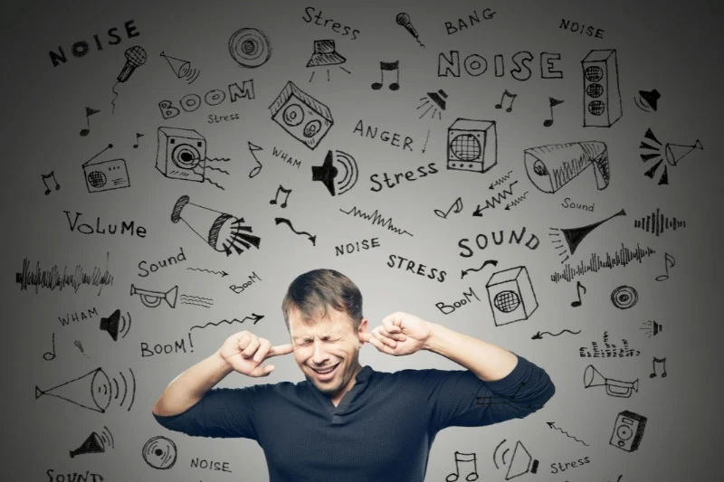
Noise: interruption that can creep in at any point of the communication process and make it ineffective. These can be emotional, physical and language.

Slide 10
Types of communication
Written communication: reports, publications, booklets, letters
Oral communication: talking to individuals, groups, crowds and masses
Special communication for special groups: deaf, dumb, blind, illiterate (uses signs and symbols)
Action oriented communication: drama, music, role plays (big impact and provides learning and entertainment)

Slide 11
Non verbal communication: Body language
Eye contact,
sign language,
para language (conveys emotions and attitude)
Haptic communication uses touch as a means of communication

Slide 12
Non verbal communication: Media
Pictures
Graphics
Sound
Writing

Slide 13
Special Needs Communication
Braille for the blind
Signs for the deaf and dumb
Large print for the elderly
Pictures for the illiterate
Conventional signs and symbols that cut across culture and languages (road, buildings, labels, Chemical signs, trade)

